Slide 1
Applied Machine Learning and Data Mining
Week 3: Data Understanding
Dr. Alaa Mohasseb
Notes:
A dataset can come in different formats, such as a spreadsheet, a table, a list, or even a collection of files.
Data Frame:
A data frame is a specific way to organize data, like a table or a spreadsheet.
Think of a data frame as a neat and structured way to present your data, like a well-arranged chart or a table with rows and columns.
Data frames are commonly used in computer programming, especially with data analysis tools like Pandas in Python

Slide 2
Last Week
Learn about the History of Machine Learning.
Gain an understanding of the different types of Machine learning algorithms
Identify the different Applications of data mining and Machine Learning in the real world.

Slide 3
This Week Learning Objectives
Getting Introduced to Data Mining Process (CRISP-DM)
Learn What is Data Understanding
Understanding the Different Characteristics of the Data
Gain an Understanding of the Data Quality Dimensions.

Slide 4
To Understand Your Data, Start by Understanding Your Business

Slide 5

Data Mining Process
Business understanding
Deployment
Data Understanding
Data Mining Process
Evaluation
Data
preparation
Modelling

Slide 6

CRISP-DM
The CRoss Industry Standard Process for Data Mining (CRISP-DM) is a process model with six phases that naturally describes the data science life cycle.
Source: https://en.wikipedia.org/wiki/Cross-industry_standard_process_for_data_mining

Slide 7
Data Mining Process (CRISP-DM)
Business understanding – What does the business need?
Data understanding – What data do we have / need? Is it clean?
Data preparation – How do we organize the data for modeling?
Modeling – What modeling techniques should we apply?
Evaluation – Which model best meets the business objectives?
Deployment – How do stakeholders access the results?

Slide 8
Any good project starts with a deep understanding of the customer’s needs

Slide 9
Business Understanding
Determine business objectives
Determine data mining goals
Assess situation
Produce project plan

Slide 10
Data Understanding
Collect initial data
Explore data
Describe data
Verify data quality

Slide 11
What are the characteristics of your Data?

Slide 12
Data Understanding
Structured Data
Unstructured Data
Numerical Data
Categorical Data
1
2
3
4
5
What you find in DB (typically)
What you find in the ‘wild’(text, audio, video)
Name | Age
John | 21
Mike | 25
E
A
b
d
Time Series Data
c
Text
Adapted from sources: structured-vs-unstructured-data.png
1*D8B5_HlEfwSQURgQkymoBA.jpeg

Slide 13
Structured vs Unstructured Data

Slide 14
Structured Data
Organised
Categorised as quantitative data
Example:
Names
Dates
Addresses
Credit card numbers
Stock information
Geolocation
Structured Data
What you find in DB (typically)

Slide 15
Unstructured Data
No pre-defined format or Organisation
Categorised as qualitative data
Example
Text
Video
Audio
Mobile activity
Social media activity
Unstructured Data
What you find in the ‘wild’(text, audio, video)

Slide 16
Data Types

Slide 17
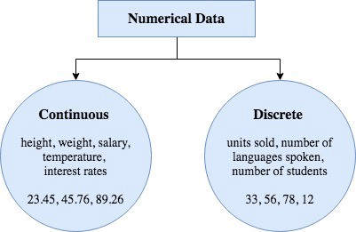
Numerical Data
Numerical data is a data type expressed in numbers, rather than natural language description.
There are two types of numerical data:
Numerical Data
Categorical Data
01.
Discrete data: represent countable items
02.
Continuous data: represent data measurement
Source:https://towardsdatascience.com/data-types-from-a-machine-learning-perspective-with-examples-111ac679e8bc

Slide 18
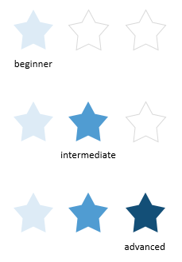

Categorical Data
Categorical data is a collection of information that is divided into groups
There are three types of categorical data:
01.
Nominal Data
02.
Ordinal Data
03.
Binary Data
Source:https://towardsdatascience.com/data-types-from-a-machine-learning-perspective-with-examples-111ac679e8bc

Slide 19

Text
Consists of documents which can represent:
A.
Words
B.
Sentences
C.
Paragraphs
Usually unstructured
Source:https://towardsdatascience.com/data-types-from-a-machine-learning-perspective-with-examples-111ac679e8bc

Slide 20
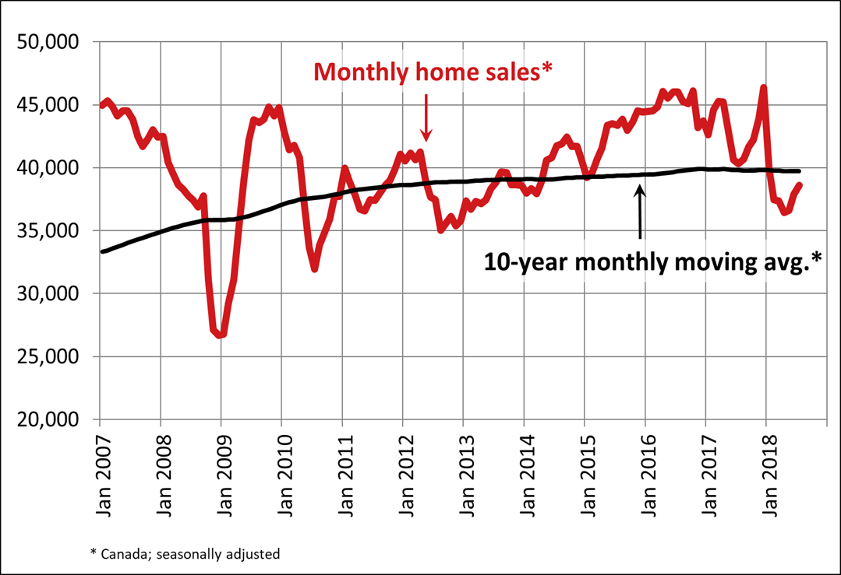
Time Series Data
Also referred to as time-stamped data
Is a sequence of data points indexed in time order
Time-stamped is data collected at different points in time
Source:https://towardsdatascience.com/data-types-from-a-machine-learning-perspective-with-examples-111ac679e8bc

Slide 21
Other Characteristics

Slide 22
Missing Values
Missing data (or missing values) is defined as the data value that is not stored for a variable in an observation.
There are different types of missing values:
Unknown
Unrecorded
Irrelevant
ID | First Name | Last Name | Gender | DOB | Course
1 | John | Smith | Male |  | CS
2 | Sarah | William |  |  | CS
3 | David |  | Male |  | CS
Notes:
**FLEA – animation on slide**

Slide 23
Inaccurate Values
Data that has not been collected for mining which result in errors.
These errors might affect the accuracy of the data mining but might not affect the original purpose of the data
ID | First Name | Last Name | Gender | DOB | Course
1 | John | Smith | Male | 0/0/1998 | CS
2 | Sarah | Female | Female | 20/03/2002 | CS
3 | David | Jason | Male | 55/10/2001 | Computer Science
Female
55/10/2001
Computer Science
Notes:
**FLEA – animation on slide**

Slide 24
Imbalanced Data
It is the problem in machine learning where the total number of a class of data is far less than the total number of another class of data.
Count
100
No Fraud
Fraud
Class
Image Adapted from: miro.medium.com

Slide 25
Data Quality

Slide 26
Data Quality Dimensions
Validity
Accuracy
Data Quality
Consistency
Completeness
Timeliness
Uniqueness

Slide 27
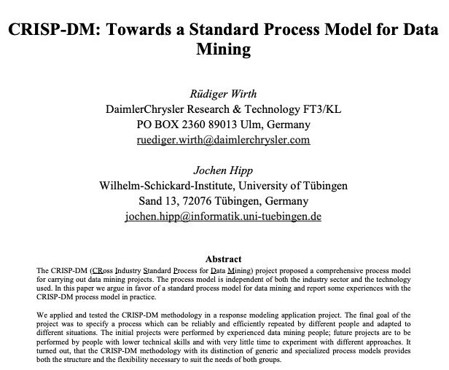
Reading for this week
CRISP-DM: Towards a Standard Process Model for Data Mining

Slide 28
In-Class Exercise
Twitter Data - Link
Headline News - Link
Amazon- Link

